Slide 1


CONFLICT RESOLUTION
Prepared by the research team

Slide 2
Learning Objectives
01
To enable students to learn the strategies to resolve conflicts
02

Slide 3

How to deal with conflict situations?

Slide 4

Negotiate

Slide 5

Solve the problem

Slide 6

Communication Skills

Slide 7

Listening

Slide 8
Asking Question

Slide 9

Assertive action

Slide 10

Manage emotions and tempers

Slide 11

Resolve the conflict in a healthy way

Slide 12

Be polite and respectful

Slide 13

Tools for Conflict Management

Slide 14

BLAME
What doesn’t work?

Slide 15

The “third story”
What does work?

Slide 16
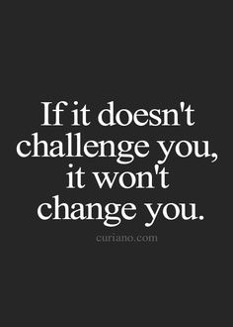

Slide 17
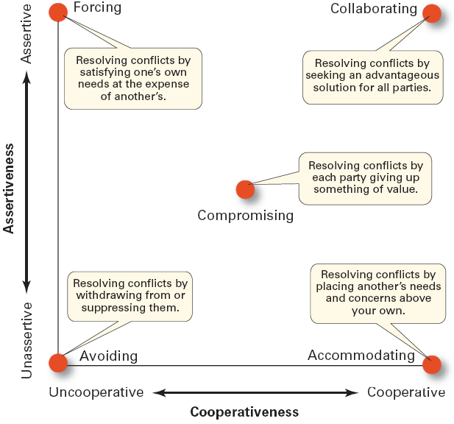
Conflict-Management Techniques

Slide 18
Benefits of Problem solving skills
Your acceptance as a leader.
Boost organizational morale.
Inspire effective team work.
Promote involvement to address issues.
Promote the culture of leadership development.
Reduce communication gap.
Brings cost reduction.
Better motivation among employees.
Changes from negative to positive environment.

Slide 19
Thank you

